Slide 1
Edge Detection

Slide 2
Example
1 | 0 | -1
1 | 0 | -1
1 | 0 | -1
0 | 0 | 0 | 0 | 0 | 0 | 0 | 0 | 0 | 0
0 | 0 | 0 | 0 | 20 | 20 | 20 | 0 | 0 | 0
0 | 0 | 0 | 0 | 20 | 20 | 20 | 0 | 0 | 0
0 | 0 | 0 | 0 | 20 | 20 | 20 | 0 | 0 | 0
0 | 0 | 0 | 0 | 20 | 20 | 20 | 0 | 0 | 0
0 | 0 | 0 | 0 | 20 | 20 | 20 | 0 | 0 | 0
0 | 0 | 0 | 0 | 20 | 20 | 20 | 0 | 0 | 0
0 | 0 | 0 | 0 | 0 | 0 | 0 | 0 | 0 | 0
-1 | 0 | 1
-1 | 0 | 1
-1 | 0 | 1

Slide 3
0 | 0 | 0 | 0 | 0 | 0 | 0 | 0 | 0 | 0
0 | 0 | 0 | 0 | 20 | 20 | 20 | 0 | 0 | 0
0 | 0 | 0 | 0 | 20 | 20 | 20 | 0 | 0 | 0
0 | 0 | 0 | 0 | 20 | 20 | 20 | 0 | 0 | 0
0 | 0 | 0 | 0 | 20 | 20 | 20 | 0 | 0 | 0
0 | 0 | 0 | 0 | 20 | 20 | 20 | 0 | 0 | 0
0 | 0 | 0 | 0 | 20 | 20 | 20 | 0 | 0 | 0
0 | 0 | 0 | 0 | 0 | 0 | 0 | 0 | 0 | 0
1 | 0 | -1
1 | 0 | -1
1 | 0 | -1
Vertical Edge
0 | 0 | 0 | -20 | -20 | 0 | 20 | 20 | 0 | 0
0 | 0 | 0 | -40 | -40 | 0 | 40 | 40 | 0 | 0
0 | 0 | 0 | -60 | -60 | 0 | 60 | 60 | 0 | 0
0 | 0 | 0 | -60 | -60 | 0 | 60 | 60 | 0 | 0
0 | 0 | 0 | -60 | -60 | 0 | 60 | 60 | 0 | 0
0 | 0 | 0 | -60 | -60 | 0 | 60 | 60 | 0 | 0
0 | 0 | 0 | -40 | -40 | 0 | 40 | 40 | 0 | 0
0 | 0 | 0 | -20 | -20 | 0 | 20 | 20 | 0 | 0

Slide 4
0 | 0 | 0 | 0 | 0 | 0 | 0 | 0 | 0 | 0
0 | 0 | 0 | 0 | 20 | 20 | 20 | 0 | 0 | 0
0 | 0 | 0 | 0 | 20 | 20 | 20 | 0 | 0 | 0
0 | 0 | 0 | 0 | 20 | 20 | 20 | 0 | 0 | 0
0 | 0 | 0 | 0 | 20 | 20 | 20 | 0 | 0 | 0
0 | 0 | 0 | 0 | 20 | 20 | 20 | 0 | 0 | 0
0 | 0 | 0 | 0 | 20 | 20 | 20 | 0 | 0 | 0
0 | 0 | 0 | 0 | 0 | 0 | 0 | 0 | 0 | 0
-1 | 0 | 1
-1 | 0 | 1
-1 | 0 | 1
Vertical Edge
0 | 0 | 0 | 20 | 20 | 0 | -20 | -20 | 0 | 0
0 | 0 | 0 | 40 | 40 | 0 | -40 | -40 | 0 | 0
0 | 0 | 0 | 60 | 60 | 0 | -60 | -60 | 0 | 0
0 | 0 | 0 | 60 | 60 | 0 | -60 | -60 | 0 | 0
0 | 0 | 0 | 60 | 60 | 0 | -60 | -60 | 0 | 0
0 | 0 | 0 | 60 | 60 | 0 | -60 | -60 | 0 | 0
0 | 0 | 0 | 40 | 40 | 0 | -40 | -40 | 0 | 0
0 | 0 | 0 | 20 | 20 | 0 | -20 | -20 | 0 | 0

Slide 5
0 | 0 | 0 | 0 | 0 | 0 | 0 | 0 | 0 | 0
0 | 0 | 0 | 0 | 20 | 20 | 20 | 20 | 0 | 0
0 | 0 | 0 | 0 | 20 | 20 | 20 | 20 | 0 | 0
0 | 0 | 0 | 0 | 20 | 20 | 20 | 20 | 0 | 0
0 | 0 | 0 | 0 | 20 | 20 | 20 | 20 | 0 | 0
0 | 0 | 0 | 0 | 20 | 20 | 20 | 20 | 0 | 0
0 | 0 | 0 | 0 | 20 | 20 | 20 | 20 | 0 | 0
0 | 0 | 0 | 0 | 0 | 0 | 0 | 0 | 0 | 0
Vertical Edge
0 | 0 | 0 | 20 | 20 | 0 | 0 | -20 | -20 | 0
0 | 0 | 0 | 40 | 40 | 0 | 0 | -40 | -40 | 0
0 | 0 | 0 | 60 | 60 | 0 | 0 | -60 | -60 | 0
0 | 0 | 0 | 60 | 60 | 0 | 0 | -60 | -60 | 0
0 | 0 | 0 | 60 | 60 | 0 | 0 | -60 | -60 | 0
0 | 0 | 0 | 60 | 60 | 0 | 0 | -60 | -60 | 0
0 | 0 | 0 | 40 | 40 | 0 | 0 | -40 | -40 | 0
0 | 0 | 0 | 20 | 20 | 0 | 0 | -20 | -20 | 0

Slide 6
1 | 1 | 1
0 | 0 | 0
-1 | -1 | -1
0 | 0 | 0 | 0 | 0 | 0 | 0 | 0 | 0 | 0
0 | 0 | 0 | 0 | 0 | 0 | 0 | 0 | 0 | 0
20 | 20 | 20 | 20 | 20 | 20 | 20 | 20 | 20 | 20
20 | 20 | 20 | 20 | 20 | 20 | 20 | 20 | 20 | 20
20 | 20 | 20 | 20 | 20 | 20 | 20 | 20 | 20 | 20
20 | 20 | 20 | 20 | 20 | 20 | 20 | 20 | 20 | 20
0 | 0 | 0 | 0 | 0 | 0 | 0 | 0 | 0 | 0
0 | 0 | 0 | 0 | 0 | 0 | 0 | 0 | 0 | 0
Horizontal Edge
0 | 0 | 0 | 0 | 0 | 0 | 0 | 0 | 0 | 0
40 | 60 | 60 | 60 | 60 | 60 | 60 | 60 | 60 | 60
40 | 60 | 60 | 60 | 60 | 60 | 60 | 60 | 60 | 60
0 | 0 | 0 | 0 | 0 | 0 | 0 | 0 | 0 | 0
0 | 0 | 0 | 0 | 0 | 0 | 0 | 0 | 0 | 0
-40 | -60 | -60 | -60 | -60 | -60 | -60 | -60 | -60 | -60
-40 | -60 | -60 | -60 | -60 | -60 | -60 | -60 | -60 | -60
0 | 0 | 0 | 0 | 0 | 0 | 0 | 0 | 0 | 0

Slide 7
0 | 0 | 0 | 0 | 0 | 0 | 0 | 0 | 0 | 0
0 | 0 | 0 | 0 | 0 | 0 | 0 | 0 | 0 | 0
20 | 20 | 20 | 20 | 20 | 20 | 20 | 20 | 20 | 20
20 | 20 | 20 | 20 | 20 | 20 | 20 | 20 | 20 | 20
20 | 20 | 20 | 20 | 20 | 20 | 20 | 20 | 20 | 20
20 | 20 | 20 | 20 | 20 | 20 | 20 | 20 | 20 | 20
0 | 0 | 0 | 0 | 0 | 0 | 0 | 0 | 0 | 0
0 | 0 | 0 | 0 | 0 | 0 | 0 | 0 | 0 | 0
1 | 0 | -1
1 | 0 | -1
1 | 0 | -1
Vertical filter on Horizontal Edge
0 | 0 | 0 | 0 | 0 | 0 | 0 | 0 | 0 | 0
20 | 0 | 0 | 0 | 0 | 0 | 0 | 0 | 0 | 0
40 | 0 | 0 | 0 | 0 | 0 | 0 | 0 | 0 | 0
60 | 0 | 0 | 0 | 0 | 0 | 0 | 0 | 0 | 0
60 | 0 | 0 | 0 | 0 | 0 | 0 | 0 | 0 | 0
40 | 0 | 0 | 0 | 0 | 0 | 0 | 0 | 0 | 0
20 | 0 | 0 | 0 | 0 | 0 | 0 | 0 | 0 | 0
0 | 0 | 0 | 0 | 0 | 0 | 0 | 0 | 0 | 0

Slide 8
0 | 0 | 0 | 0 | 0 | 0 | 0 | 0 | 0 | 0
0 | 0 | 0 | 0 | 20 | 20 | 20 | 20 | 0 | 0
0 | 0 | 0 | 0 | 20 | 20 | 20 | 20 | 0 | 0
0 | 0 | 0 | 0 | 20 | 20 | 20 | 20 | 0 | 0
0 | 0 | 0 | 0 | 20 | 20 | 20 | 20 | 0 | 0
0 | 0 | 0 | 0 | 20 | 20 | 20 | 20 | 0 | 0
0 | 0 | 0 | 0 | 20 | 20 | 20 | 20 | 0 | 0
0 | 0 | 0 | 0 | 0 | 0 | 0 | 0 | 0 | 0
1 | 1 | 1
0 | 0 | 0
-1 | -1 | -1
Horizontal filter on Vertical Edge
0 | 0 | 0 | 20 | 40 | 60 | 60 | 40 | 20 | 0
0 | 0 | 0 | 20 | 40 | 60 | 60 | 40 | 20 | 0
0 | 0 | 0 | 0 | 0 | 0 | 0 | 0 | 0 | 0
0 | 0 | 0 | 0 | 0 | 0 | 0 | 0 | 0 | 0
0 | 0 | 0 | 0 | 0 | 0 | 0 | 0 | 0 | 0
0 | 0 | 0 | 0 | 0 | 0 | 0 | 0 | 0 | 0
0 | 0 | 0 | -20 | -40 | -60 | -60 | -40 | -20 | 0
0 | 0 | 0 | -20 | -40 | -60 | -60 | -40 | -20 | 0

Slide 9
0 | 0 | 0 | 0 | 0 | 0 | 0 | 0 | 0 | 0
0 | 0 | 0 | 0 | 0 | 0 | 20 | 20 | 0 | 0
0 | 0 | 0 | 0 | 0 | 20 | 20 | 0 | 0 | 0
0 | 0 | 0 | 0 | 20 | 20 | 0 | 0 | 0 | 0
0 | 0 | 0 | 20 | 20 | 0 | 0 | 0 | 0 | 0
0 | 0 | 20 | 20 | 0 | 0 | 0 | 0 | 0 | 0
0 | 20 | 20 | 0 | 0 | 0 | 0 | 0 | 0 | 0
0 | 0 | 0 | 0 | 0 | 0 | 0 | 0 | 0 | 0
0 | -1 | -1
1 | 0 | -1
1 | 1 | 0
Diagonal Edge
0 | 0 | 0 | 0 | 0 | 0 | -20 | -40 | -20 | 0
0 | 0 | 0 | 0 | 0 | 0 | -20 | -40 | -20 | 0
0 | 0 | 0 | 0 | 0 | 0 | 0 | 0 | 0 | 0
0 | 0 | 0 | 0 | 0 | 0 | 0 | 0 | 0 | 0
0 | 0 | 0 | 0 | 0 | 0 | 0 | 0 | 0 | 0
0 | 0 | 0 | 0 | 0 | 0 | 0 | 0 | 0 | 0
20 | 40 | 20 | 0 | 0 | 0 | 0 | 0 | 0 | 0
20 | 40 | 20 | 0 | 0 | 0 | 0 | 0 | 0 | 0

Slide 10
Types of edge detection operators
Roberts
Sobel
Prewitt
Canny
Krisch
LoG

Slide 11

Roberts Edge Operator

Slide 12
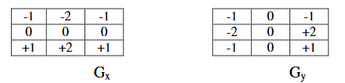
Sobel edge operator

Slide 13
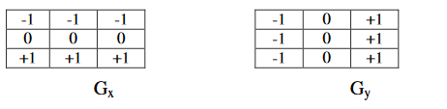
Prewitt edge operator

Slide 14
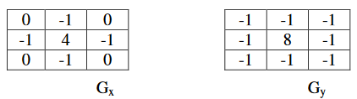
LoG Edge Operator

Slide 15
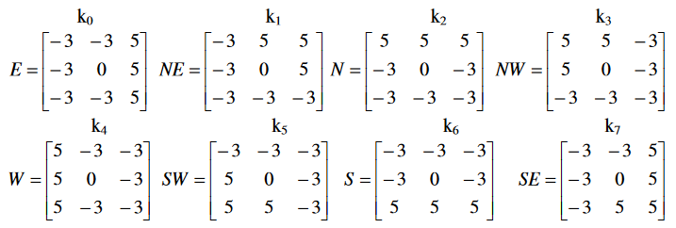
Krisch operator

Slide 16
Canny edge detection
The Process of Canny edge detection algorithm can be broken down to 5 different steps:
Apply Gaussian filter to smooth the image in order to remove the noise
Find the intensity gradients of the image
Apply non-maximum suppression to get rid of spurious response to edge detection
Apply double threshold to determine potential edges
Track edge by hysteresis: Finalize the detection of edges by suppressing all the other edges that are weak and not connected to strong edges.

Slide 18
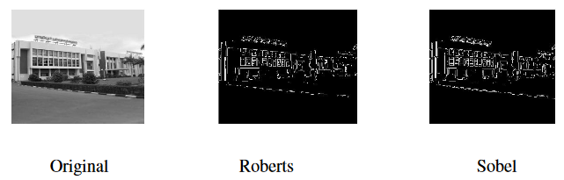
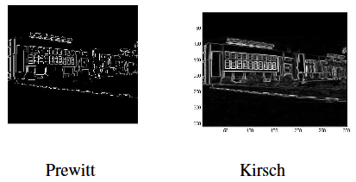
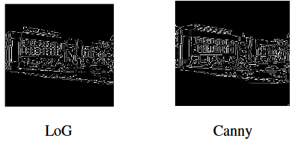

Slide 19
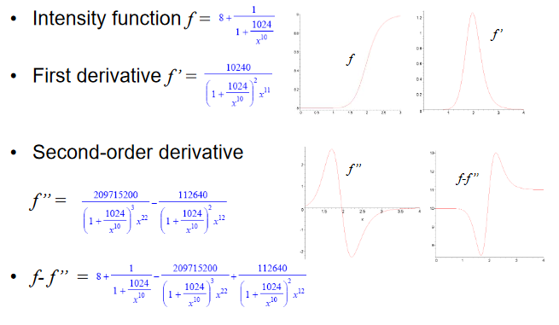
First and Second order derivatives

Slide 20
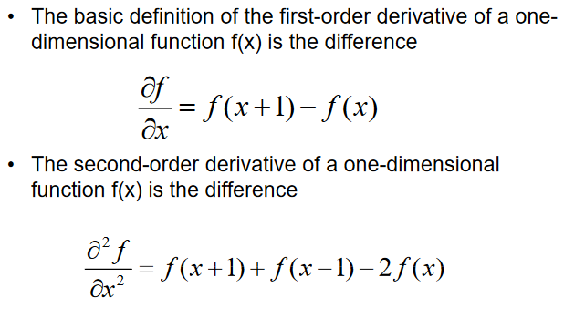

Slide 21
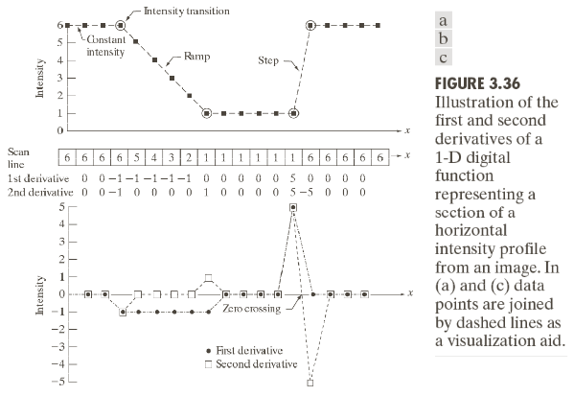

Slide 22
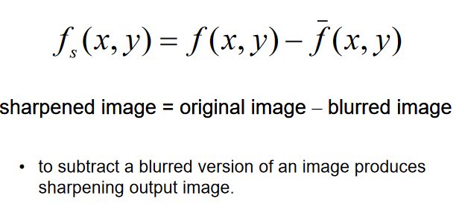
Unsharp masking

Slide 23
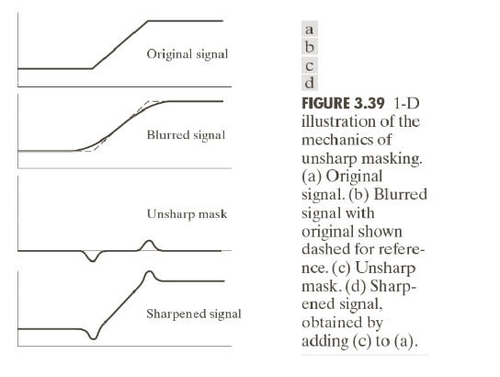
Unsharp mask working

Slide 24
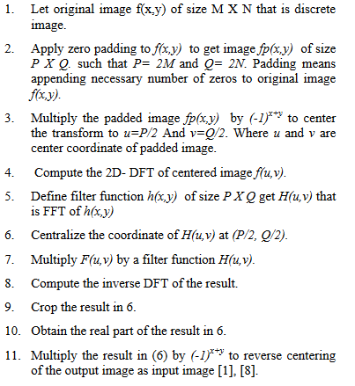
Frequency filter

